Slide 1
Early Headship Coaching Offer Live Q&A Briefing
Notes:
Introductions
Very warm welcome
Congratulations on headship
Exciting that this programme is now open to those in the first five years of headship

Slide 2
Early Headship Coaching Offer for new headteachers
To provide new headteachers with a structured, unassessed support programme based on the best available evidence about what makes an effective headteacher.
The Early Headship Coaching Offer is a targeted package of support aimed at new headteachers and based on the NPQH content framework, which has been reformed to ensure it is underpinned by the latest and best evidence.
“Evidence shows that support is more effective when tailored to the needs and context of the headteacher.”
DfE 2020
Notes:
This is the background to the programme – DfE providing funding for support for new headteachers
£800 per participant
Structured unassessed
Self-led

Slide 3
Early Headship Coaching Offer – who is it for?
The Early Headship Coaching Offer (EHCO) is for new headteachers who are in their first five years of headship who:
are currently taking the existing NPQH
have completed the reformed NPQH and are in their first five years of headship
have done a legacy NPQH, regardless of when they finished it, providing they are within their first five years of headship
The Early Headship Coaching Offer must last for at least the duration of the headteacher’s first year in role and the delivery should consider their workload.
It is available for all new eligible headteachers regardless of phase or context.
Notes:
The Early Headship Coaching Offer (formerly ASO) is for all new headteachers regardless of phase or context.
The EHCO is based on the ten core areas of the reformed NPQH to continue leadership development on from the NPQH programme and the Headteachers’ Standards 2020
If you are on the NPQH programme currently – since Autumn 2021 – these core areas will be increasingly familiar to you. The learning on the EHCO will compliment and extend that provided through the NPQH.
As long as you are within the first five years of headship and you have taken or are currently taking an NPQH, you are eligible for this programme.
It does not matter which provider you did your programme with. There will be a check that you have done this to ensure your eligibility.
Participants are required to register on the DfE portal to access the funding.

Slide 4
About the Early Headship Coaching Offer
This DfE fully funded, unassessed programme has been designed to be a practical self-led programme with a pathway shaped by a skills audit supported by leadership performance coaching.
It provides the opportunity to focus specifically on personal areas of development.
Flexible, blended learning to integrate into the working week
Builds on NPQH ten core areas
Focussed professional development support
Coaching
Connecting with other headteachers – opportunities to develop a regional network
Expert- led network groups - professional conversations aligned to personal development needs
No in-school mentor or sponsor required
Notes:
When devising this programme, we have carefully considered a new head’s workload and so it is personalised and that means you will not be undertaking activities for the sake of it – only if they are relevant to you.
The duration of the programme is over four terms, so there is plenty of time to access resources and activities.
Much of the programme will be delivered virtually, so you will not be required to take time out of school.
The coaching pathway will be informed by a skills audit and this will be further supported by a coaching conversation from a leadership coach, which you undertake following completion of the audit. More details of that will follow in a minute.
There will be opportunities to connect with other new headteachers in a learning support network and also to gain valuable insight from expert leaders in small groups.
As this programme is personalised and unassessed, there is no requirement for a sponsor or mentor. It is about you and for you.

Slide 5
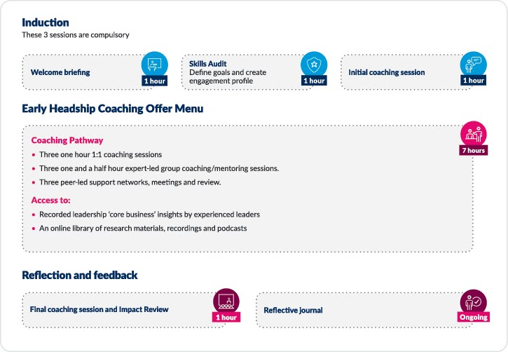
Notes:
Programme aligned to the NPQH ten content areas and the Headteachers’ Standards 2020. All activities based around the participant’s chosen priority content areas.
MUST attend the peer-led network support, your coaching appointments and the powerful leadership conversation groups – aligned to your areas of focus.

Slide 6
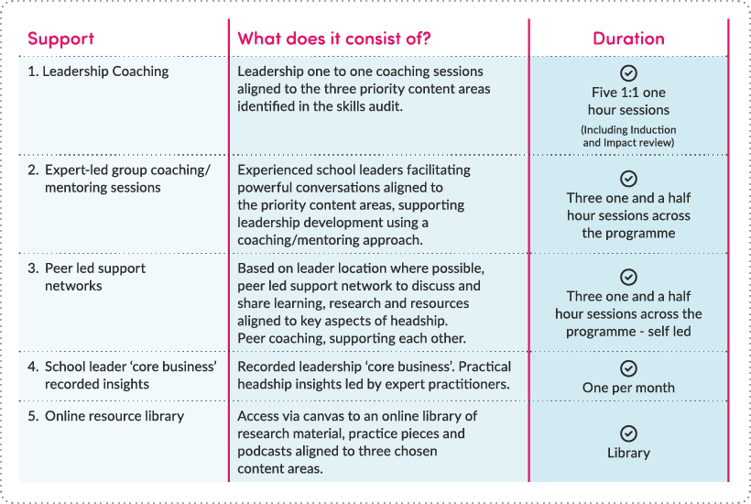
Early Headship Coaching Offer
Notes:
This shows the programme in a really clear way.

Slide 7
During the programme, participants will focus on three of these core content areas
School Culture | Teaching | Curriculum and Assessment | Behaviour | Additional and SEND
Professional Development | Organisational Management | Implementation | Working in Partnership | Governance and Accountability
Notes:
These are the core areas you are familiar with and form the basis for the structure of the programme.
The library will be sorted into these ten areas and you will be given access to the three areas you have highlighted. If you were given access to it all it would create overload, and this is not the purpose of the EHCO – again, this highlights the need to make your initial choices wisely and why we have given coach support with this.

Slide 8
School Culture | Teaching | Curriculum and Assessment | Behaviour | Additional and SEND
Establishing and sustaining the school’s strategic direction | Establishing and sustaining effective planning and preparation across the school | Coherent vision for successful learning | Establishing and sustaining a positive, predictable and safe environment for pupils | Creating clear expectations for statutory duties and targeted support
Setting ambitious standards for all pupils and staff | Curriculum design and planning | Designing and implementing a carefully sequenced and coherent curriculum | Creating and implementing a clear, consistent and coherent school behaviour policy | Effective use of different forms of assessment to identify relevant and additional pupil support
Communicating strategic direction to the school and wider community | Whole school approach to Literacy | Securing knowledge to help teachers to motivate pupils and teach effectively | Tailoring approaches informed by evidence and research | Adapting teaching responsively
Articulating and modelling practice that contributes to the intended school culture | Effective explanation and modelling | Creating fair and transparent testing/examination policies, processes and systems | Modelling specific behaviours | Specialist support
Securing alignment between curriculum, assessment and teaching | Identifying and sharing effective practice | Identifying and sharing effective curriculum and assessment practice | Using data to refine and improve whole school behaviour approach | Effective intervention approaches and use of resources
Using language that promotes challenge, aspiration, high pupil expectations and professional standards | Ensuring teaching across the school stimulates pupil thinking and understanding | Monitoring and evaluating curriculum and assessment impact on pupil learning | Selecting and adapting appropriate interventions | Setting clear expectations to ensure pupils experience success
Implementing and monitoring school policies | Monitoring and evaluating impact on pupil outcomes |  | Motivating pupils to value mastering content
Notes:
These are the first 5 of the 10 core areas from the NPQH and Headteachers’ Standards, which will form the basis of your needs analysis. You will highlight three priority areas where you want to develop your knowledge further and this will form your learning pathway.
We will show you the next sheet and then the actual audit so you can see how it is formatted.

Slide 9
Professional Development | Organisational Management | Implementation | Working in Partnership | Governance and Accountability
Align professional development priorities to school improvement focus on a shared responsibility for improving outcomes for all pupils | Financial management | Strategic planning, preparing, delivering and embedding change suitable to the school context | Establishing good relationships and partnerships | Ethical governance
Ensure colleagues engage in effective professional development | Human and educational resource management | Implementation as an ongoing process | Parental engagement and home learning strategies | School structures and accountability arrangements
Ensure teachers are able to continually develop specialist subject and domain expertise | Strategic planning | Communicating and resourcing change | Sharing effective practice | School leader accountability and scrutiny measures
Professional environment is supportive with high quality dialogue and collaboration | Risk management | Distributed school leadership | Inter school collaboration and capacity building | Staff professional responsibilities and accountability
Understand and apply ECF, ITT core framework, Teachers Standards and CPD standards | Safeguarding | Diagnostic process and interpreting data | Understanding roles and responsibilities of complex partnerships | Participation in an accountability to effective governance
 | Appraising and managing staff performance | Developing a clear implementation plan, identifying problems and identifying priority areas for improvement |  | Develop appropriate evidence-informed strategies for improvement which are realistic, timely, and suited to the school’s context
 | Ensure careful and effective implementation of improvement strategies, which lead to sustained school improvement over time | Monitoring, evaluating and sustaining school improvement
Notes:
2nd 5 of the 10

Slide 10
Early Headship Coaching Offer skills audit
Differences in starting points for the EHCO will be accommodated through a skills audit that maps current skills against NPQH content statements and Headteachers’ Standards so areas of development focus can be identified.
Each of the content area statements is to be rated by participants in the following way: little or no experience, developing experience, strong experience, substantial experience.
Outcomes of the skills audit survey will be discussed with the leadership coach to support participants’ final decision about their three priority focus content areas that will align to little or no experience/developing experience rating.
The three priority focus content areas will form the basis for each participant’s EHCO pathway and associated elements of the programme, including leadership coaching and networks.
New headteachers will lead their learning development journey rather than following a prescribed path. The skills audit, together with the schedule of activities and evidence-informed resources, are available to support decision making and setting direction for learning development activity.
Notes:
Apologies for the amount of text here, but you will receive these slides and they do provide clarity on the audit process.
Let’s look at the audit.
Please note at the top it says use your log in for Canvas – this is for those doing NPQH with us currently.
If you are NOT doing NPQH with us, please just use your email address – the one you used when you applied.

Slide 11
Any questions?

Slide 12
Office hours:
Monday to Friday
9am to 5pm
(excluding bank holidays)
Headship support team
headshipsupport@bestpracticenet.co.uk Tel: 01179 209 200
Lead Facilitator: Alis Rocca
alisrocca@bestpracticenet.co.uk

